Slide 1
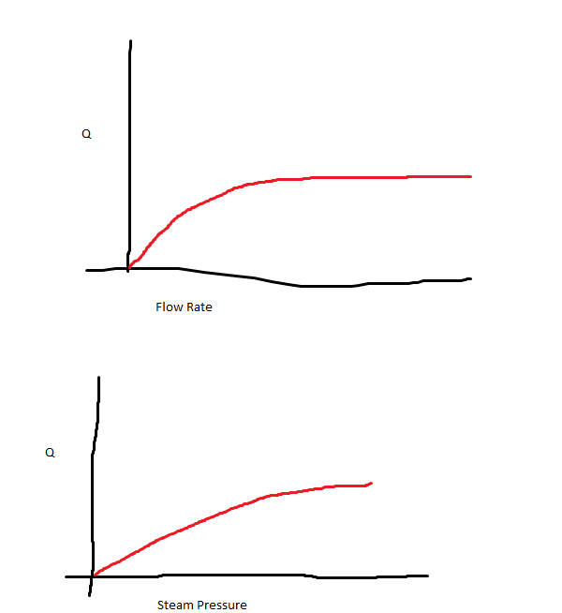






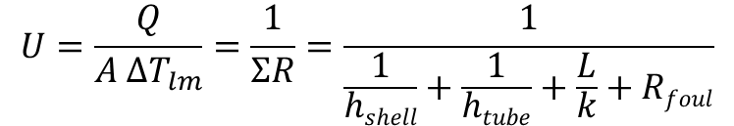

$ΔT_{lm}={(ΔT}_{2}−{ΔT}_{1})/(ln⁡({ΔT}_{2}$/${ΔT}_{1})$
Expected outcomes as per Dr. Hecker’s
instructions
$$Q=\dot{m}c_{p}ΔT=UAΔT_{lm}$$
$$Q=\dot{m}c_{p}{ΔT}_{water}$$
$$U=\frac{Q}{A {ΔT}_{lm}}=\frac{1}{ΣR}=\frac{1}{\frac{1}{hshell}+\frac{1}{htube}+\frac{L}{k}+Rfoul}$$
Sample Calculation
(get h and k from Nusselt or literature values)
$$Q=3\frac{m^{3}}{s} \left(4.184\right)\frac{J}{mol K}(70−57)°C$$
$ΔT_{lm}=(100−70)−(100−57))/(ln⁡(30$/$43)$
$$U=\frac{Q}{(2 m^{2}) {ΔT}_{lm}}≈1300\frac{W}{m^{2}K}$$
$$Rfoul=\frac{1}{U}−\frac{1}{hshell}−\frac{1}{htube}−\frac{L}{k}≈−100$$
Water in
Water out
Heat Exchanger
Steam in
Steam out

